Slide 1
PS III Internships
Q & A

Slide 2
A few things to consider...
FAQ from students

Slide 3
Q: When is PS III offered?

Slide 4
PS III Semesters
Fall 2021
Secondary Internships (Grade 7-12)
Out of Zone (any grade)
ECE
Indigenous Education
Technology in Education (Secondary)
Spring 2022
Elementary Internships (Grade K-6)
Out of Zone (any grade)*
ECE
Inclusive Education (Zone 6 only)
Technology in Education (Elementary)

Slide 5
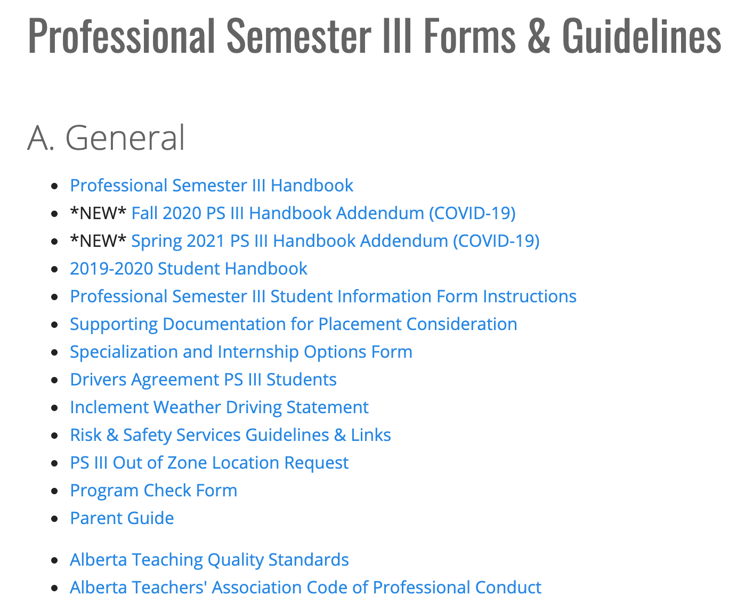

Slide 6
Q: When are Out of Zone and Specialization applications due?

Slide 7
Out of Zone Application Deadlines
Fall 2021: Due January 31
Spring 2022: Due August 15

Slide 8
Specialization Application Deadline
Fall 2021: Due mid-March
Spring 2022: Due end of September

Slide 9
Q: If I have requested a Calgary internship location, can I leave the school names blank?

Slide 10
PS III Student Information Forms
Fall 2021: Due mid-March
Spring 2022: Due end of September

Slide 11
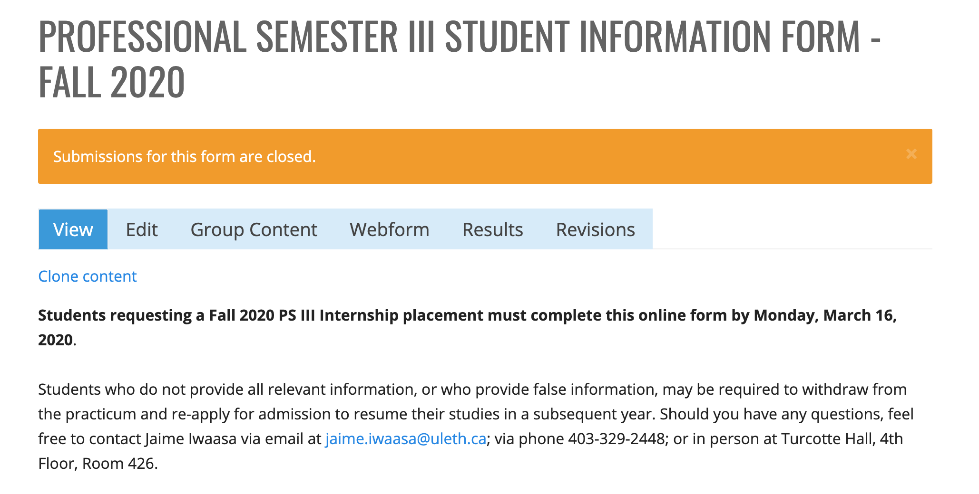

Slide 12
Q: What if I change my mind about Out of Zone?

Slide 13
Q: What if I don’t know where I will be living in the fall?

Slide 14
Q: What about Out of Province Internships?

Slide 15
PS III - Out of Province Locations
If you complete PS I and PS II Out of Province, you must return to Alberta for PS III
Student teachers must have completed a minimum of 5 weeks of practicum in Alberta (according to current ATA information)
Out of Province and Out of Zone location preferences are not guaranteed.

Slide 16
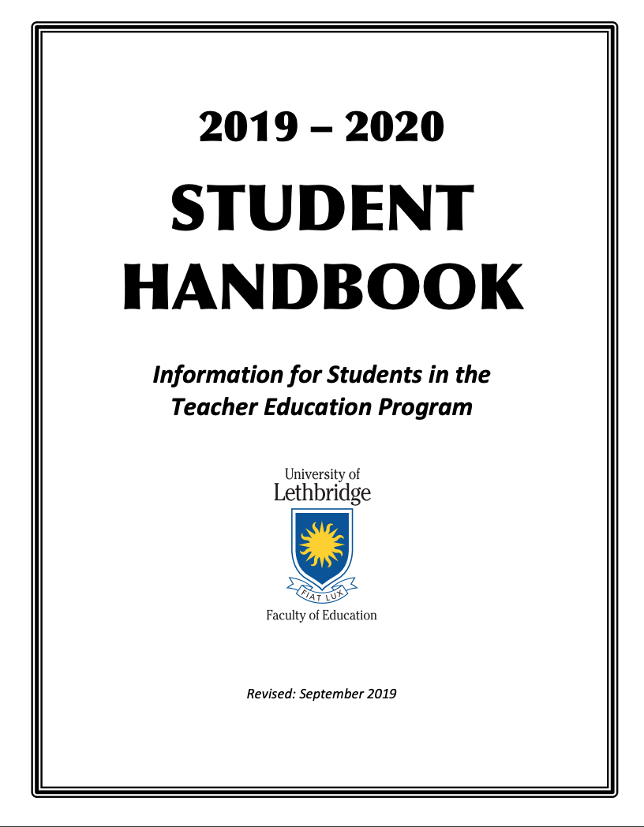
A few important resources:
Student Handbook p. 28-30
https://www.uleth.ca/education/programs-degrees/undergraduate-program/field-experiences/ps-iii/forms-guidelines
Any changes to your student information should be emailed to: jaime.iwaasa@uleth.ca

Slide 17
???

